Slide 1
IPAC Energy Efficient Data Centers and Management Tools

Slide 2
Implement Data Center Best Practices
Why Standardize?
Necessary for HACS or CACS
Jigsaw Puzzle
Racks need to be same
Racks were different sizes and shapes
Close off hot isle with containment system.
Easy to expand or add additional rack space.
Managing Power Distribution
2 each power strips per rack
A/C Placement
APC units fit within layout.

Slide 3
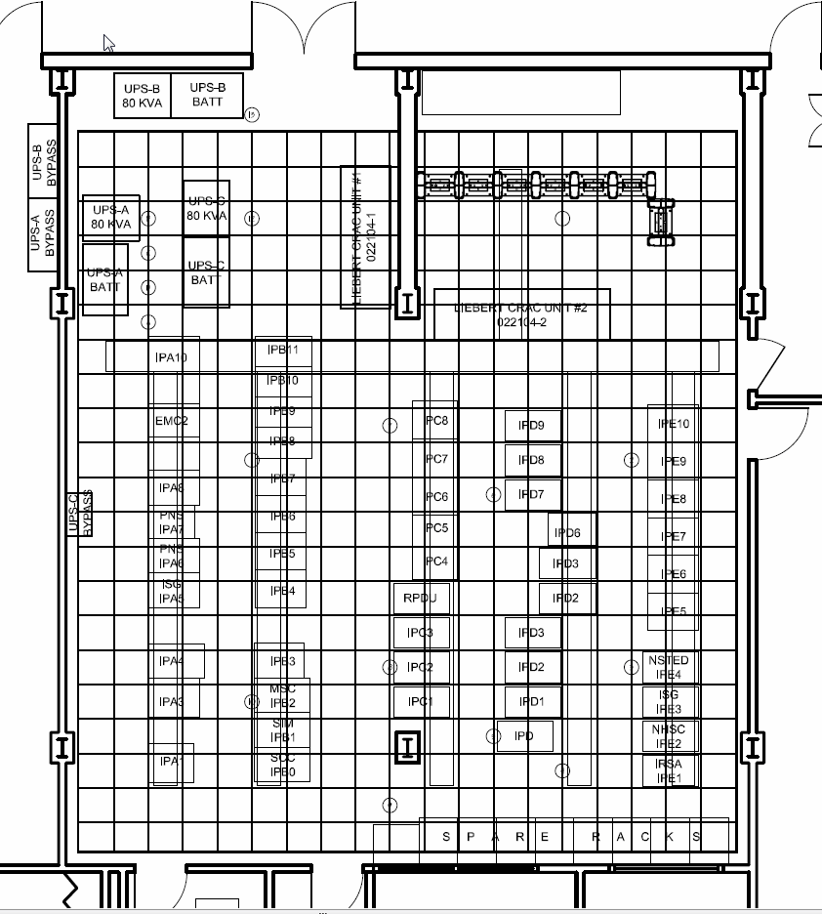

Slide 4
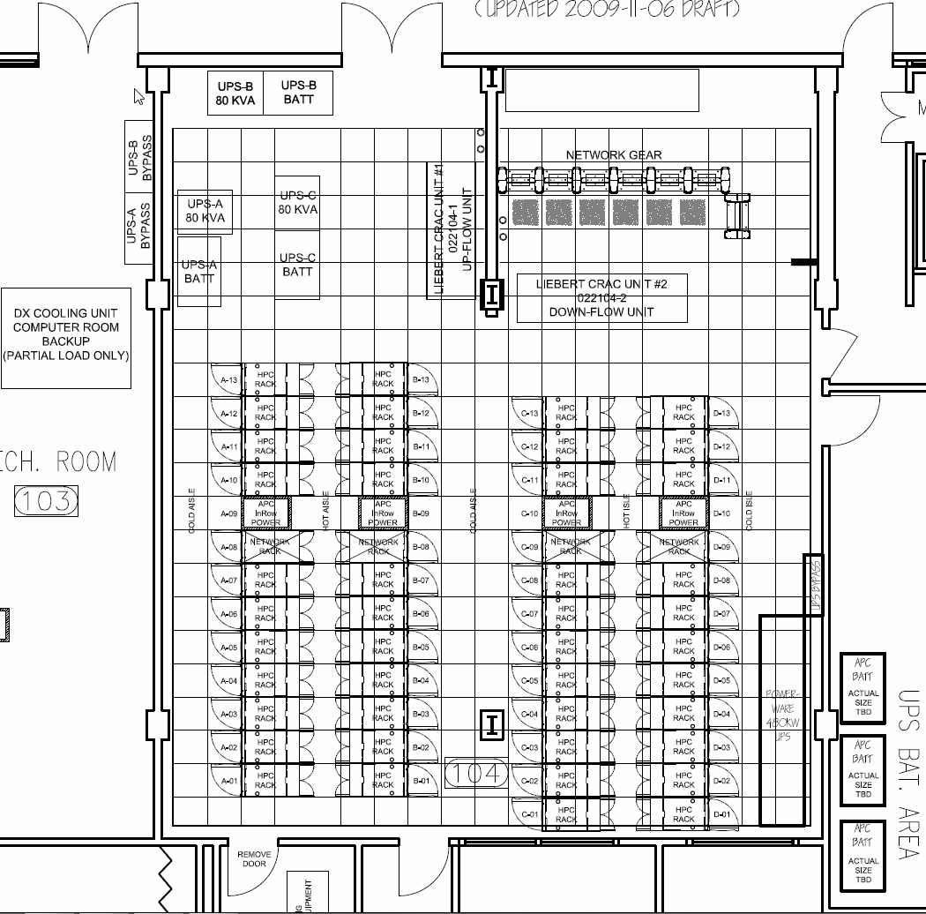

Slide 5
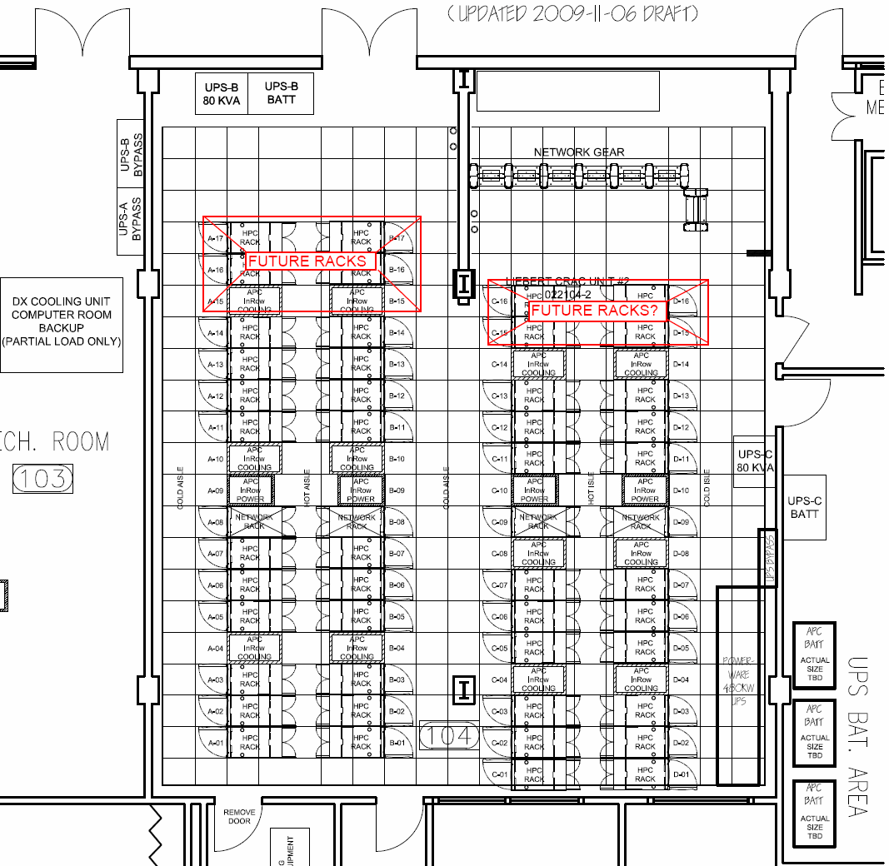

Slide 6
HACS vs. CACS

Slide 7
What’s remaining to be done?
Install ceiling fans in HACS
Why?
Relocate UPS “C”
Why?

Slide 9
Centralized Management Tools
Who needs them and why?
Remote Monitoring
Alerting
SMS “Paging”,
MMS
Email
Archive
Many Managed Devices:
5 each UPS Units 4 are 80 KVA 1 a 450 KVA unit
17 each 10 Ton A/C Units
6 each PDU 80 KVA each
9 each Environmental Monitoring Devices
108 each RPDU 2 in each rack 5 KVA
28 each RPDU 2 in each rack 10 KVA

Slide 10
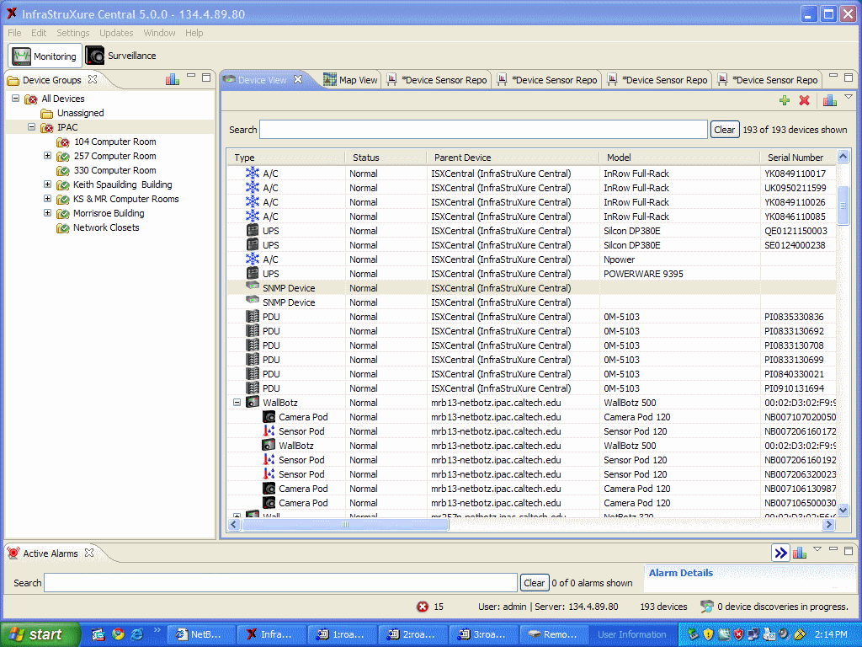

Slide 11
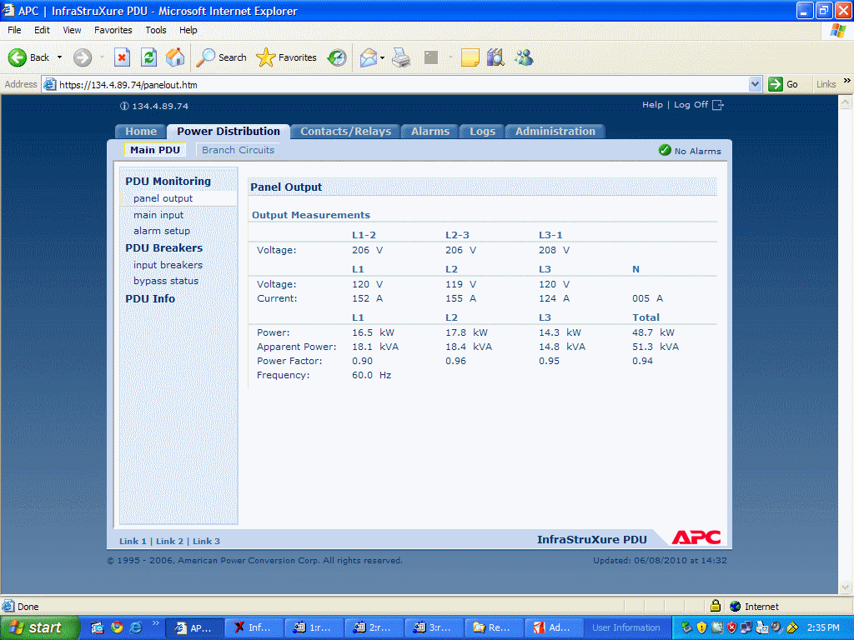

Slide 13
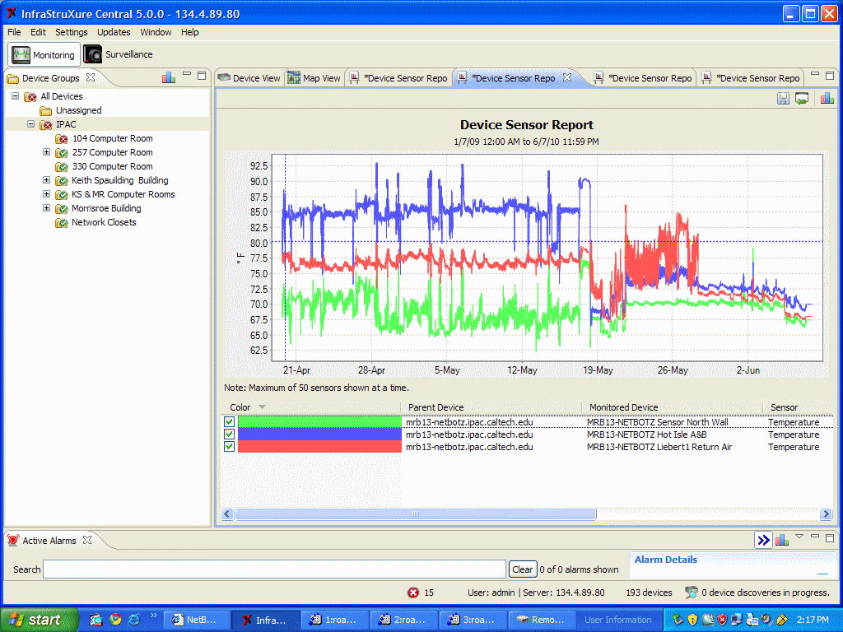

Slide 17
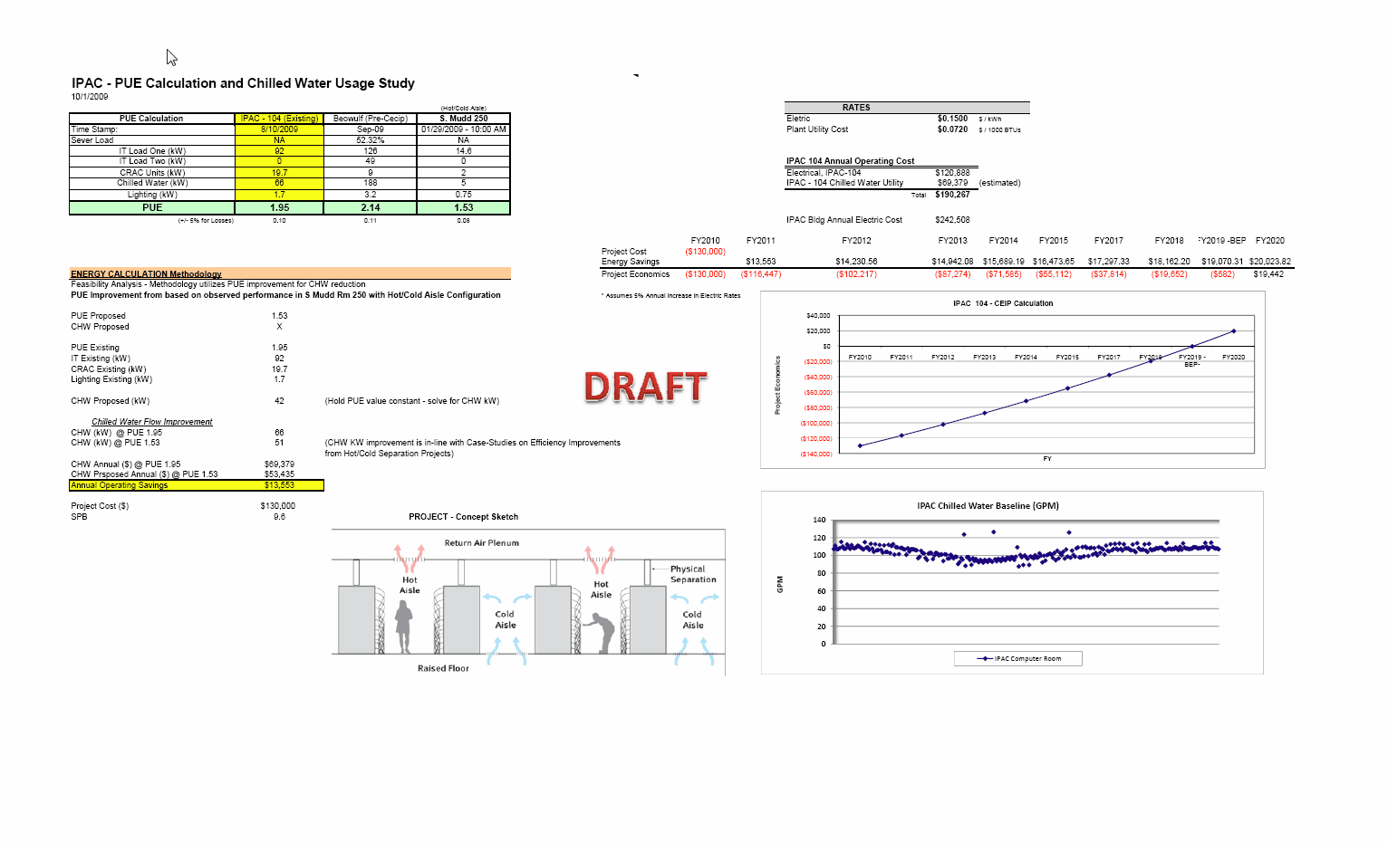

Slide 18
Data Center Cooling Challenges

